Slide 1
Taiwan
Clark
Issue: Geopolitical Tensions & Semiconductor Industry

Slide 2
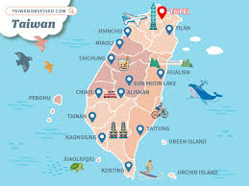
Country Background
Language: Chinese (Mandarin)
Culture: The culture in Taiwan include Han Chinese, indigenous heritage, and Japanese influences, they have famous night markets for cuisine.
Brief economic context in Taiwan:
Technology and Semiconductor Dominance
Robust Economics
Present security threats from China
when comes to economic

Slide 3
The Global Issue in Taiwan
The geopolitical tensions. The tensions between China, because of the Chinese government is considering Taiwan as just a province of theirs. But Taiwan has its own government, which means there are both confusion and arguments about Taiwan’s future status. If the conflict disrupted Taiwan’s semiconductor industry, then chip supplies could slow down, which also means the prices of electronics could rise.
The semiconductors and industry. The semiconductors are chips used in almost every electronic device, like cell phones, computers, video game consoles and many more. This is a problem because Taiwan is the only country in the world that produces a lot of those chips, at the same time its political status is disputed by China.

Slide 4
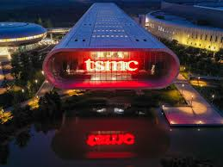
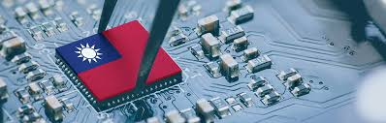
Country’s response
Taiwan’s response to the global issues they have are:
Maintain and increase strong defense towards China
Protect and fight rights for those companies
Working/allegiance with other countries such as Japan and the US
Expand their production outside of Taiwan

Slide 5
The consequences
Short term effects:
Disruptions to chip supply
Unbalanced to the stock market
More and increased military tension in Asia
Long term effects:
Changes in global chip supply chains
Taiwan remains an important island
Who is affected?
People in Taiwan
China
Technology companies worldwide
Consumer around the world like us
Governments and economics around the world
Intended consequences:
Taiwan is trying to protect their semiconductor industry, as well upgrade their national security and build international friends and allies.
Unintended consequences:
Increased tensions with China, higher costs for those semiconductors and global competition when other country is also starting their own semiconductor

Slide 6
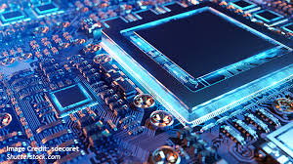
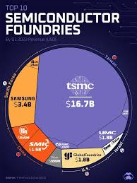
Canada: Why should Canadians care?
Canada and Canadians should care because of Canada relies on semiconductor chips for many products and industries. They’re everyday products and we use them: cell phones, computers, cars and more. Without the semiconductor which only Taiwan make the best in the world, the price of these electronics will massively increase by a terrifying amount. If Taiwan’s semiconductor falls into wrong hands like the Chinese government, then they’d threaten the entire world and demanding for a high price. They’re all evil peoples and can’t be trusted with important stuff like semiconductors.

